Slide 1


welcome

Slide 2
Teacher,s Introduction
Monjuma Sultana Head teacher
Vholoin Govt. primary School
Sadar South, Comilla

Slide 3
Class- one;Subject-English

Slide 4

Learning out comes
Students can be able to say about the picture
Students can be able to read the words

Slide 5
Heading of the lesson
The Alphabet-A……..D[Makewords]

Slide 6
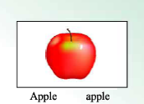
Presentation
Show the picture one by one

Slide 7



Slide 8
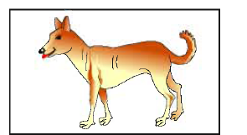

Slide 9


Slide 10


Slide 11


Slide 12
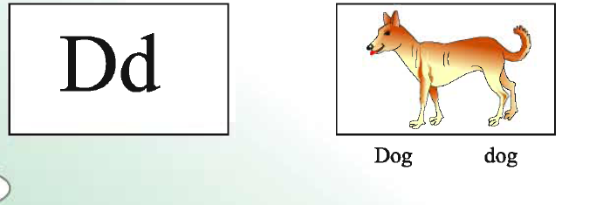

Slide 13
7;2-Teacher read the word loudly
Apple
Bag
Cap
Dog

Slide 14
7-2;Student say with me
7-3;Student say with group
7-3;Student say indivisual

Slide 15
Evaluation
Cheaking the iesson

Slide 16
Ending the ciass
Thank you

Slide 17
See again

